Slide 1
Android sweatshop II
7.7.16

Slide 2
Side note
During the session we didn't got to the TODO app
We did cover Intents and how to start a new activity

Slide 3
Last episode
Activity lifecycle
Logcat
Layouts
MATCH_PARENT vs WRAP_CONTENT
Views
OnClickListener

Slide 4
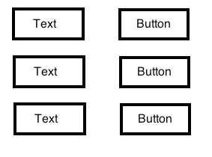
Home work
A client asked for a grid like app, each TextView should hold a separate counter
Bonus - use three horizontal LinearLayout for each row, and a vertical LinearLayout for their parent

Slide 5
Home work
Challenge - how to align them ?
Hint: LinearLayout + LinearLayouts
Any one wanna try ?

Slide 6
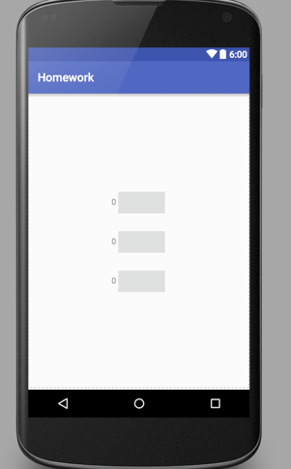
Home work UI

Slide 7
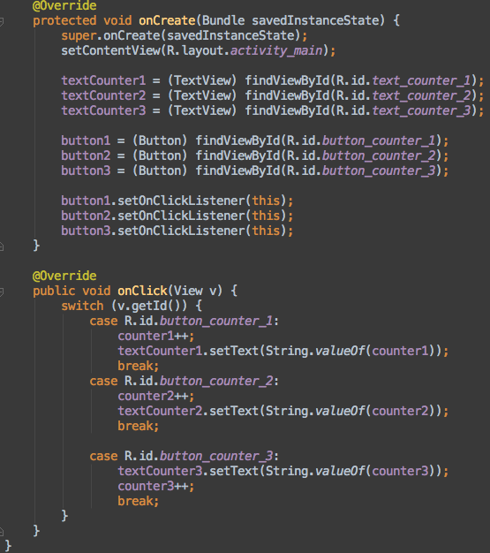
Homework solution

Slide 8
Home work activity_main.xml
RelativeLayout (why?)
LinearLayout
LinearLayout
TextView
Button
LinearLayout
TextView
Button
LinearLayout
TextView
Button

Slide 9
Content table
Pizza app (from Android For Dummies)
More views and layouts
Bitamp
Passing data to another activity
Intent
TODO app
ListView
Array adapter

Slide 10
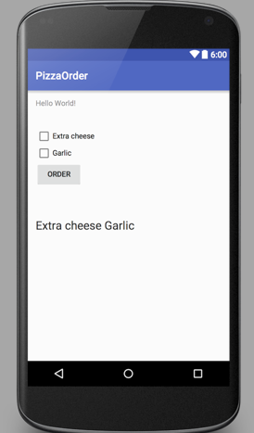
PIZZA !

Slide 11
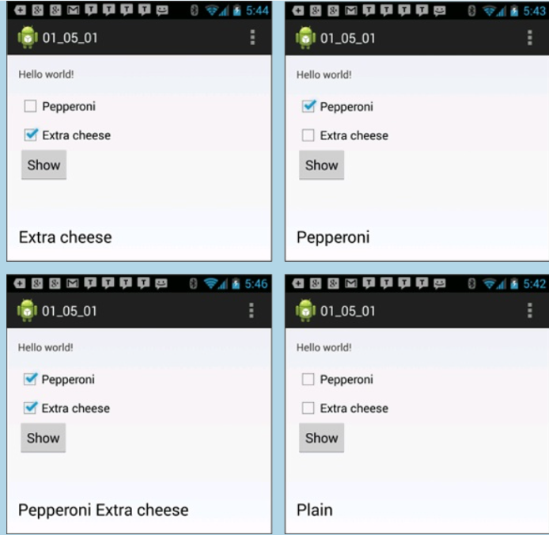
More examples

Slide 12
PIZZA - what does it do ?
Press on Order
Check which checkboxes are press
Set the order string inside the textview

Slide 13
Pizza instructions - layout designer
Drag checkboxes
Drag buttons
Drag a large TextView
Remove the HelloWorld
Change the id’s to match

Slide 14
PIZZA - MainActivity
add Class members - all of the views
private CheckBox …
set them using findViewById(R.id.view_id)
garlicCheckBox = findByViewId…

Slide 15
MainActivity - onClickListener
Set our Order button OnClickListener
Check checkboxes ;)
Update string

Slide 16

Checkbox != Chessbox

Slide 17
Adding a bitmap to an ImageView
Search for a pizza photo on google
Add it to the drawable folder
Add an ImageView to the layout
Load

Slide 18
TODO app
Waba laba dab dab

Slide 19
TODO lists are useful
We’re gonna learn more about Android UI
Activities and intents
Later: fragments, action bars, preferences, sql

Slide 20
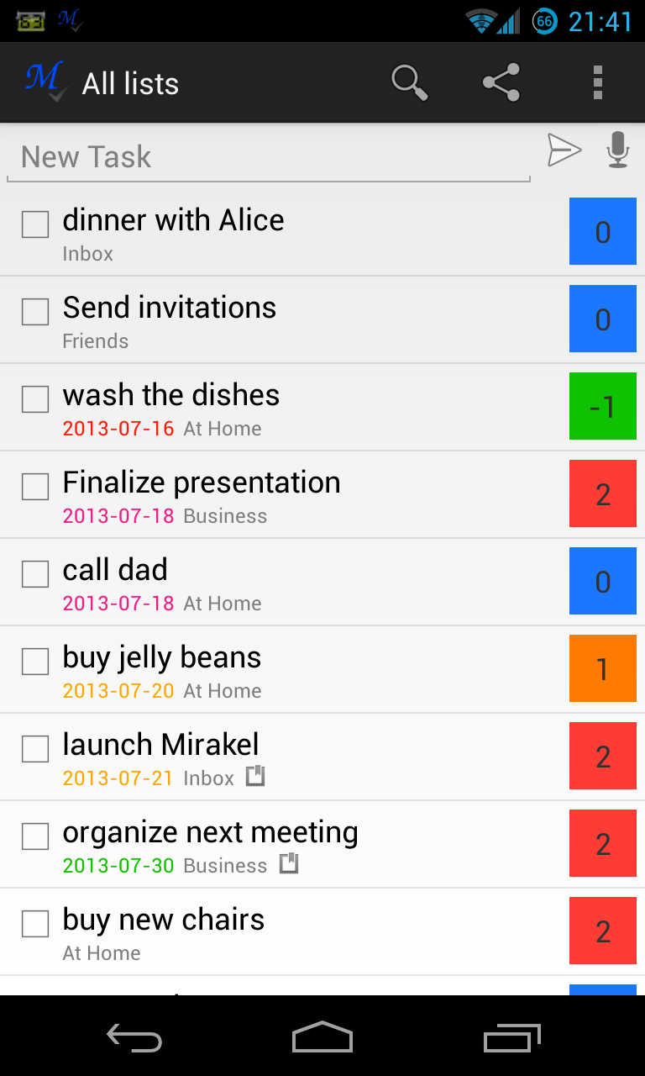
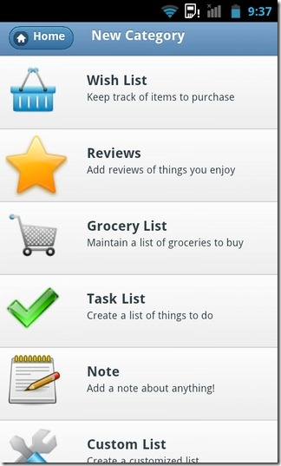
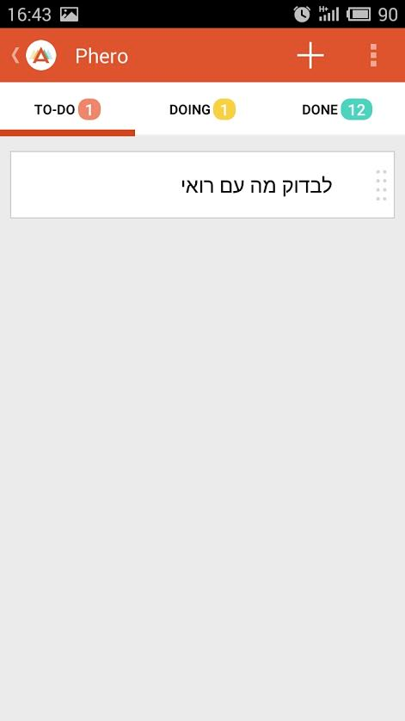
simple

Slide 21
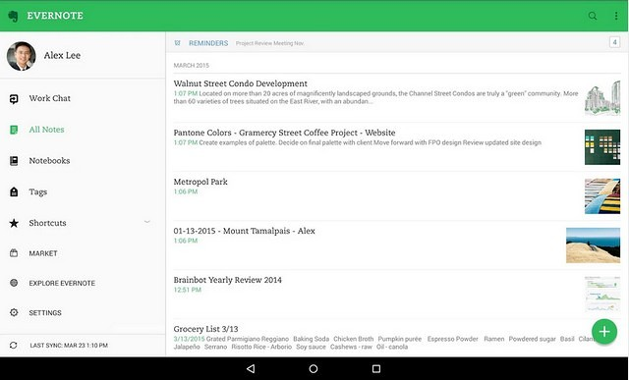
Complex

Slide 22
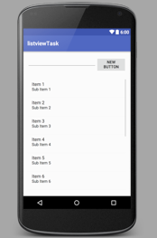
NoteListActivity
layout design
ListView
EditText field
Add TODO item button
add the text from the text field to the array
notify the adapter list changed
Later: onClick() of item starts EditActivity - now show a toast

Slide 23

ListView - code parts

Slide 24
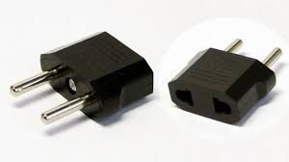
Adapter class as an Android design pattern
The Adapter pattern allows two incompatible classes to work together by converting the interface of one class into an interface expected by the clients.

Slide 25
Coding time !
Start with NoteListActivity

Slide 26
How do we add the content of the note ?
We need another activity !

Slide 27
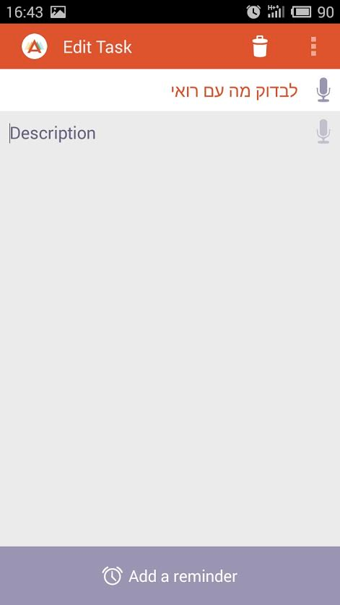
EditNoteActivity
Title of note
Body content
Edit button

Slide 28
Starting another activity
How do we move from screen to screen ?

Slide 29
Intent - special Android component
The most common use of intents is to bind your application components. Intents are used to start, stop and transition the activities within an application.

Slide 30

Of course we can add variables to this intent

Slide 31
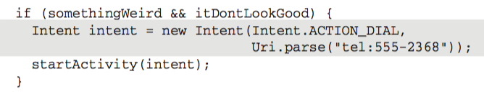

Slide 32
Receiving side
Intent intent = getIntent()

Slide 33


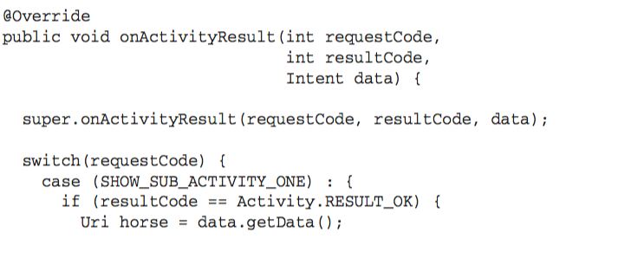
Returning results from activity
receive on the activity end

Slide 34
Practice
Start EditNoteActivity with the intent as in the example
Explicit intent
startActivityForResult(intent)
add to it a test string “test” (putExtra)
Add an edit box and a go back button and return the result back the NoteActivity
set OnClickListener for the go back button
init a new Intent
setResult(intent)
finish

Slide 35
What’s left for the note?
Long click on a note to delete
Dialog Interface
Saving the data

Slide 36
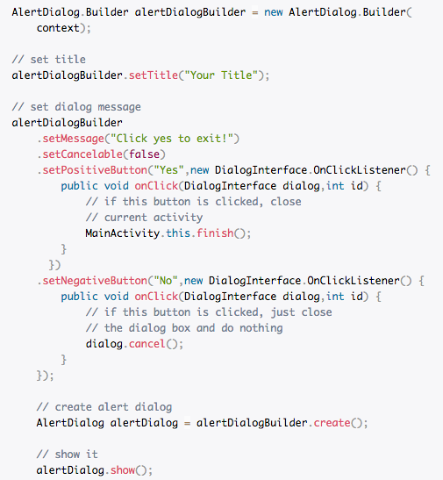
Alert dialog

Slide 37
Practice
Start a dialog on a long click of the item list view, it should ask either to delete it or not. On delete, delete.

Slide 38
Persistance
Why ? What happens when turn off the mobile ?
Exit the app ?
Too much resources are on hold ?
We lost the data -> lets save it (persist it)

Slide 39
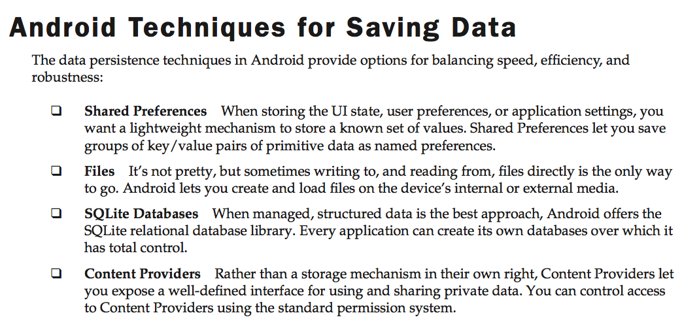

Slide 40

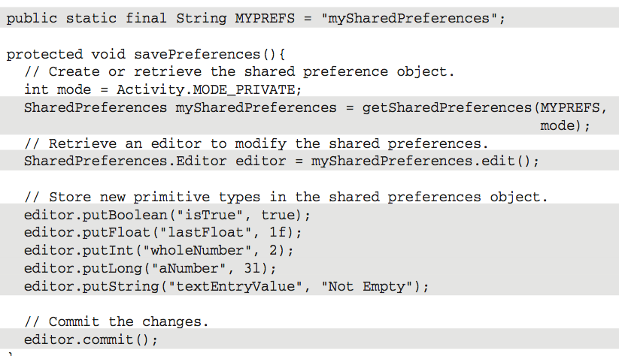

Slide 41
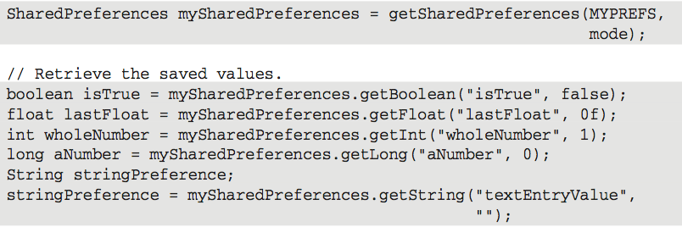

Slide 42
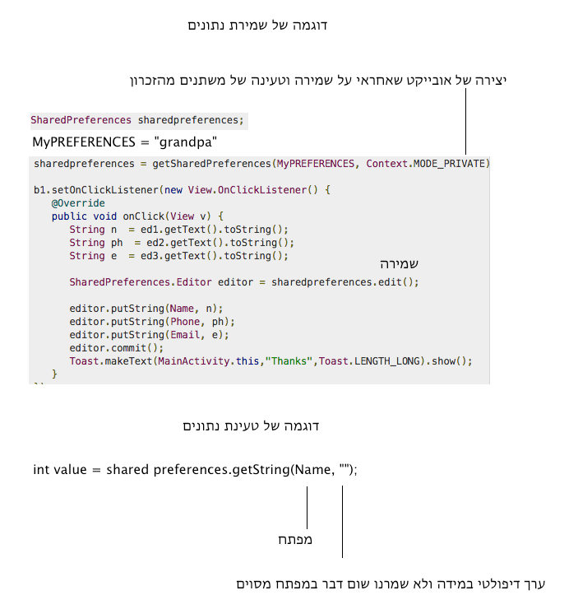

Slide 43
Practice
Create a shared preferences
Save a string
Save all title notes
Save all note details

Slide 44
Summary
Pizza app
new view - checkboxes
TODO app
Lists and adapters
Intents
AlertDialog
SharedPreferences

Slide 45
Homework
Pizza
On each checkbox switch to a different imageView
What if two checkboxes are picked ?
TODO
Different users may have different tasks
Add a login screen - username and password
Save it using SharedPreferences
Load the specific notes of the user

